Slide 1

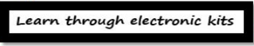

AZARUL FAHMIN BIN AB HAMID SUNGAI PETANI,KEDAH 19 AUGUST 1992 EDUCATION: DIPLOMA IN MECHATRONIC ENG. ,2013 BACHELOR OF SCIENCE MECHATRONIC ENG. , 2017 PAPER: CONNECTED CAR: ENGINE DIAGNOSTIC WITH INTERNET OF THINGS(IoT) EXPERIENCE: PROJECT FREELANCE, 2010-2016 FREELANCE TRAINER, 2012-2016 TRAINING MANAGER NADI ELECZONE, 2017 PROJECT AND AWARD: PINTAR (Penanti innovation talent recreation centre) SCIENCE ON WHEEL(NORTH REGION) EDUCATION INNOVATION AWARD, YPJ
NADI ELECZONE SOLUTIONS
SA0311162-X
CONTACT NUMBER: 013 4094377

Slide 2
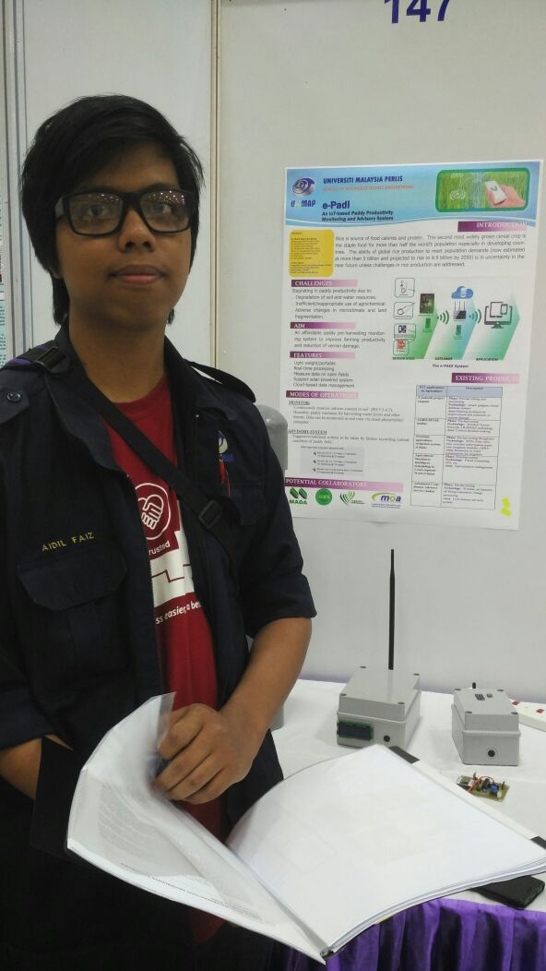
MUHAMMAD AIDIL FAIZ BIN ISMAIL KEPALA BATAS, PENANG 25 MARCH 1993 EDUCATION: DIPLOMA IN MICROELECTRONIC ENG. ,2013 BACHELOR OF ELECTRONIC ENG. , 2017 PAPER: e-Padi: An IoT Based Paddy Productivity Monitoring System EXPERIENCE: PROJECT FREELANCE, 2014-2017 FREELANCE TRAINER, 2015-2017 PROJECT AND AWARD: Gold Medal E reka UniMAP 2017 (E padi) Gold Medal I-Envex 2016 (IoT Clean room monitoring) SCIENCE ON WHEEL(NORTH REGION)
NADI ELECZONE SOLUTIONS
SA0311162-X
CONTACT NUMBER: 013 4094377

Slide 3

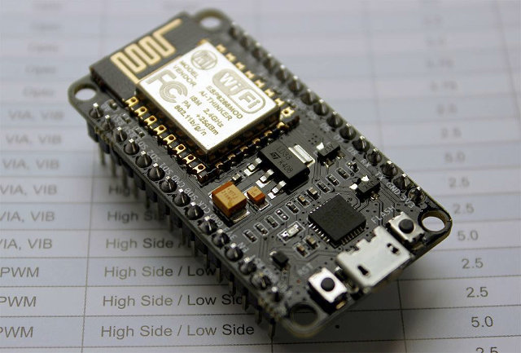
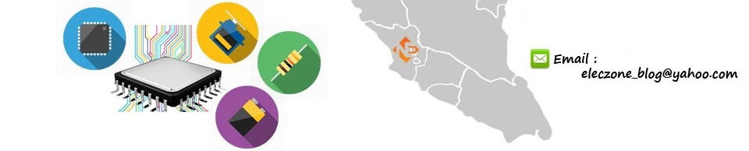
Internet of Things (IoT) Advance Training

Slide 4
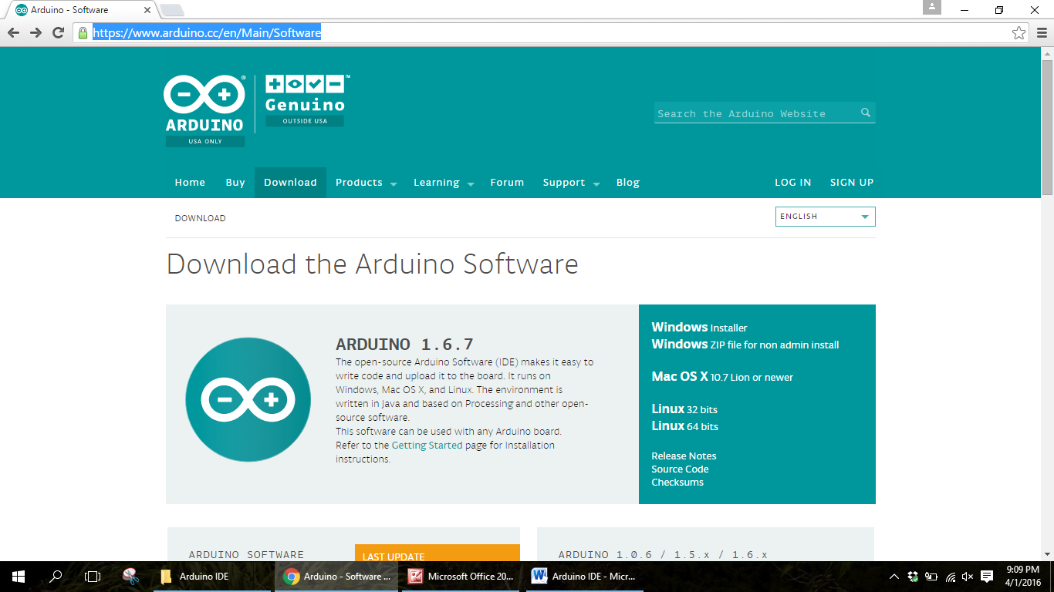
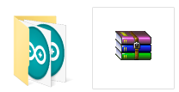
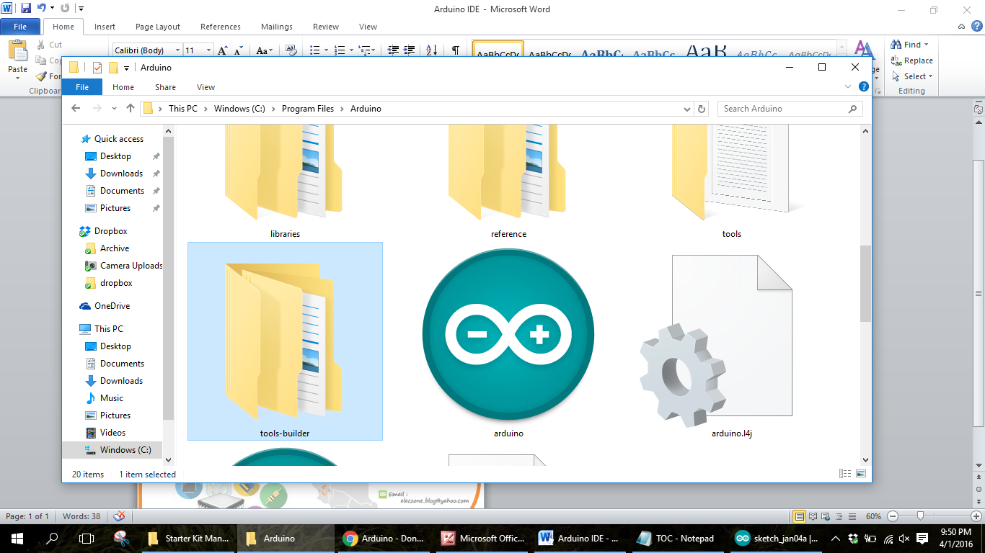
Installing Arduino IDE
1
Download the software here!!
Go to website url https://www.arduino.cc/en/Main/Software and downlad Arduino IDE software. Take the windows installer or windows zip.
2
. If you are taking the windows zip it’s mean you choose non admin install that don’t need t be install. You just have t extract the file
arduino

Slide 5
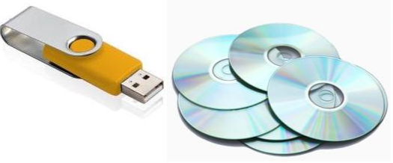
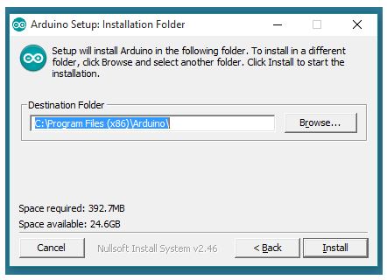
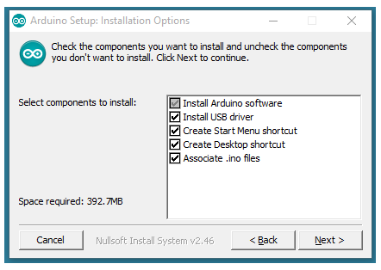
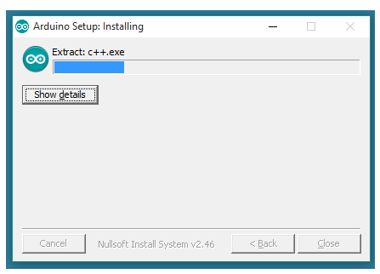
Installing Arduino IDE
Step 1
Step 3
Download/ Copy Arduino Software (IDE)
Select Installation Folder (We suggest to use- Default)
Step 4
Step 2
This process will extract and Install the file that will be use in Arduino software(IDE)
Choose component to Install

Slide 6
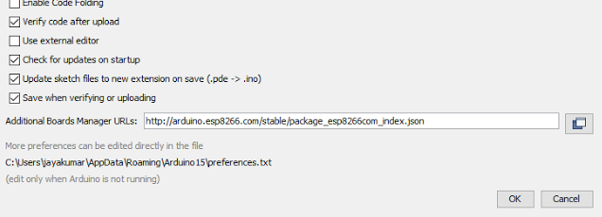
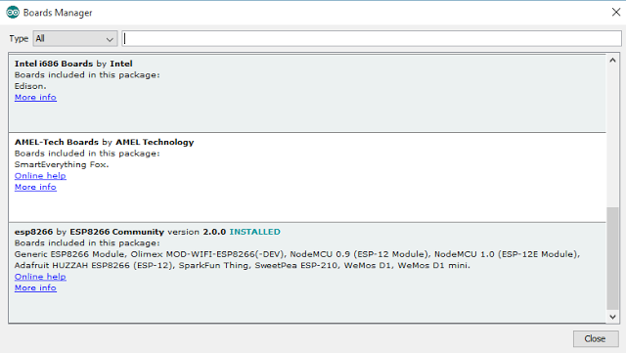
NodeMCU Board Library Setup
Go to File → Preferences copy this json url and paste http://arduino.esp8266.com/stable/package_esp8266com_index.json into Additional Board Manager URLS: then click OK
1
2
Go to Tools→Boards→Board Manager click Board Manager and then wait for a few minute until nodeMcu library link appear then click Install at esp8266 by ESP8266 community

Slide 7
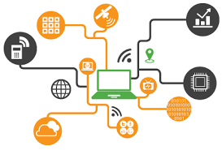
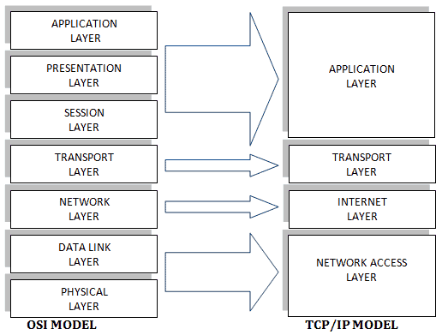
What is IoT???
Internet of Things (IoT), is one of popular word today, but most of person still don’t understand about IoT. For now we are in 4th industry revolution that will use IoT as one of technology component as a physical communication medium. IoT is a technology to communicate data(sensor, decision and etc) between any electronic devices.
Why IoT???
There are many communication method that can be make in state of wireless but why insist to use IoT as a medium of communication.

Slide 8
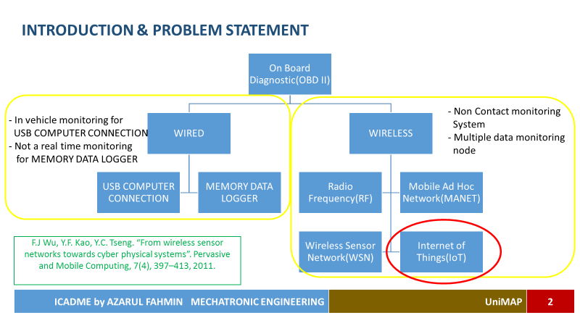

Slide 9
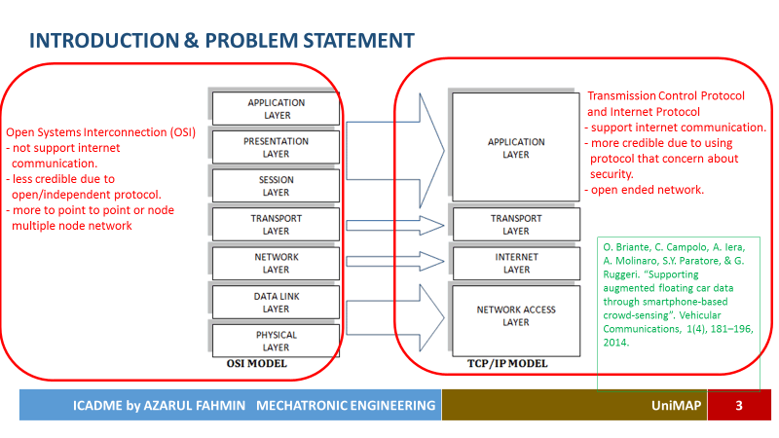

Slide 10
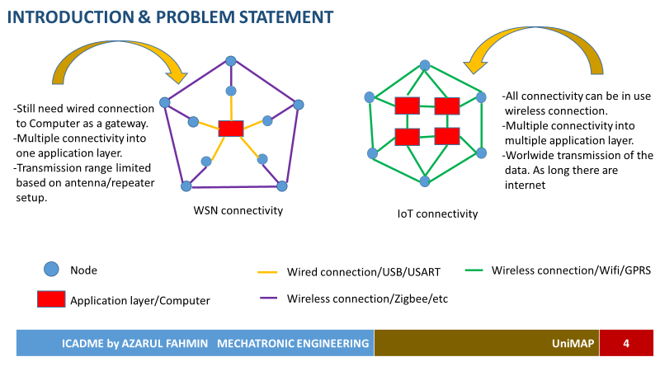

Slide 11


Slide 12


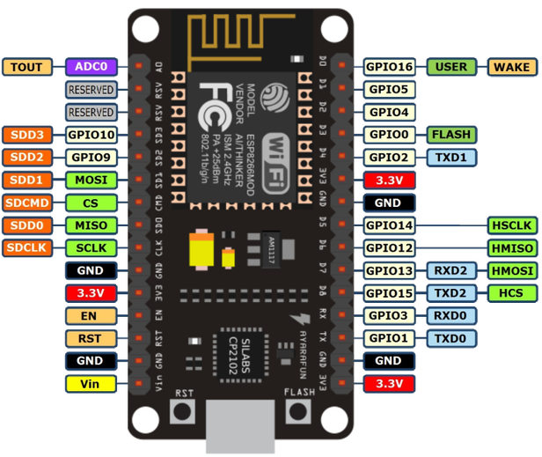
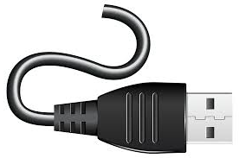
1
Get to know NodeMCU
(USB Port and GPIO)
Function of USB Port
To see NodeMCU Board status
Use to upload compiled code from Arduino IDE into NodeMCU board.

Slide 13
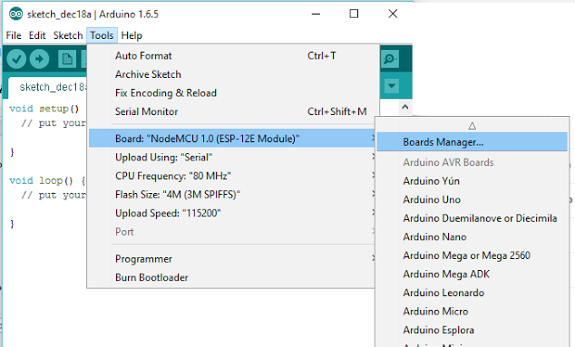
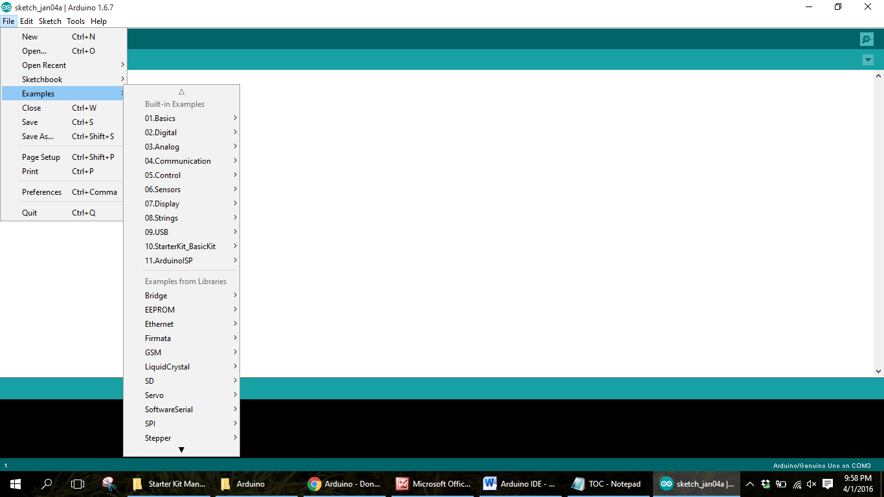
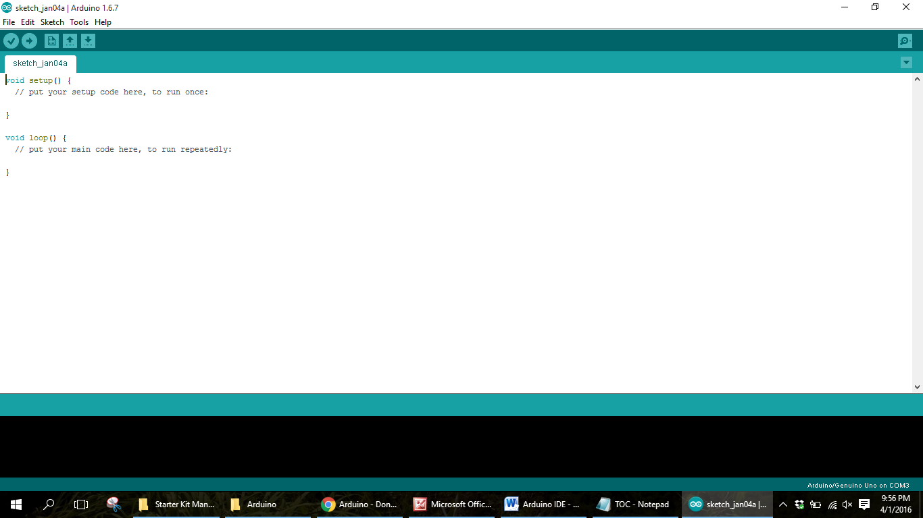
1
Here you can see if the NodeMCU board already connected to the computer by looking at the port.
Using Arduino IDE
What the important thing you need to know when the first time you are using arduino?
From here you can get many example coding to be use.
Button Verify
Button Upload
2
3

Slide 14
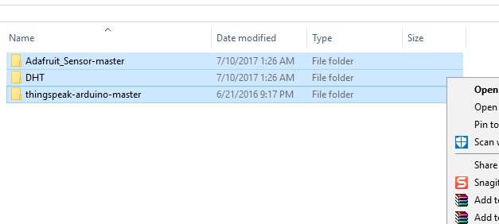
1
Copy this three library file
Arduino IDE adding library setup
2
Paste in C://Program file(x86)/Arduino/libraries

Slide 15
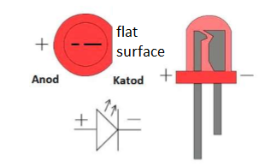
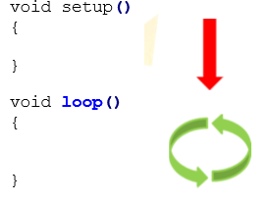
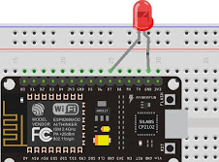
Lesson 1 : Get to know OUTPUT
1
Connect the LED to NodeMCU board.
Every program in Arduino will have one void setup() and one void loop(). Void setup() is for program code that will running once and void loop() is like main program that will continuously running
D7= pin 13 //folow pin as in GPIO pin out

Slide 16
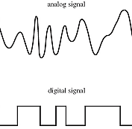
Algorithm Syntax that widely used in Arduino programming.
analogRead(pin) (INPUT)
+ꝏ
analogWrite(pin,value) (OUTPUT)
-ꝏ
digitalRead(pin) (INPUT)
1
0
digitalWrite(pin,value) (OUTPUT)

Slide 17
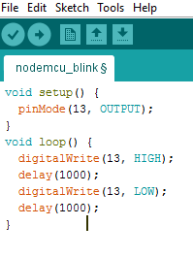
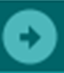
2
Lesson 1 : Get to know OUTPUT
Write the code in Arduino IDE
After done writing the code click upload . And the led will blink continuously with 1 second(delay(1000); = 1000 milisec delay).

Slide 18
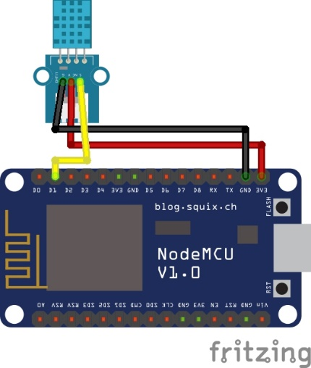
Lesson 2 : Trying DHT11
1
DHT11
Sensor pinout
-
OUT
+
GND
D1
3.3V

Slide 19
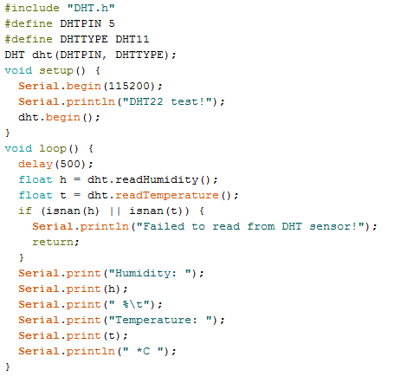
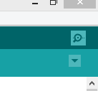
Lesson 2 : Trying DHT11
2
Library function caller
Define sensor pinout
Define DHT sensor type
Set Serial Monitor baudrate
Call function to read humidity and temperature value then store it in h and t variable.
Print data to appear in Serial Monitor. Serial.print is for print the value and when it’s come to Serial.println it will go to new line.
Done? Then go open the Serial Monitor with this icon

Slide 20
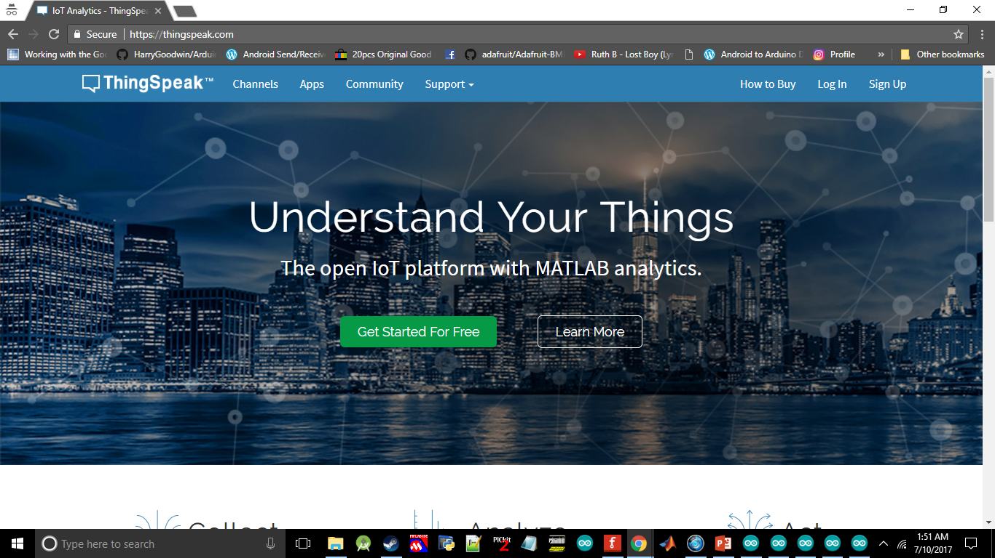
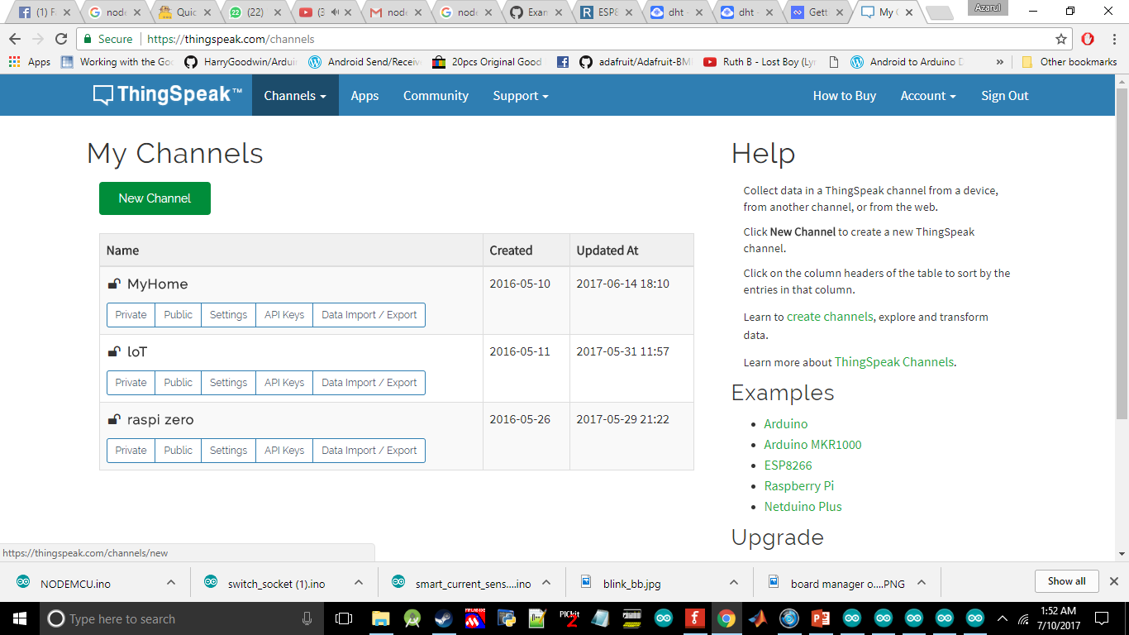
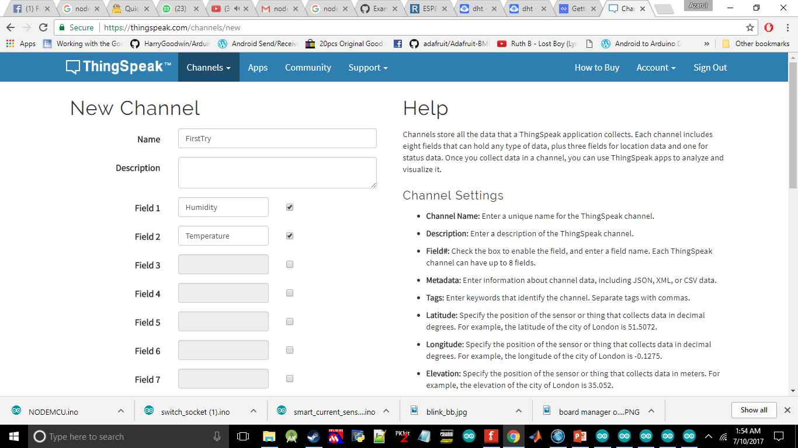
1
Goto https://thingspeak.com/ and signup. You need to validate account by using your email.
Setup Thingspeak
Click New Channel
2
3
Give a name to your channel and field for each of your sensor data. Scroll to the bottom and click save channel.

Slide 21
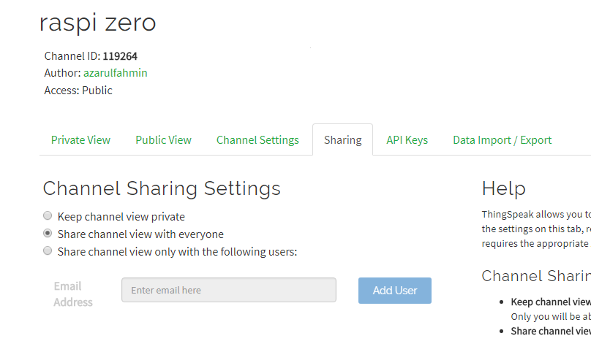
Setup Thingspeak
Go to Sharing then tick on Share channel view with everyone

Slide 22
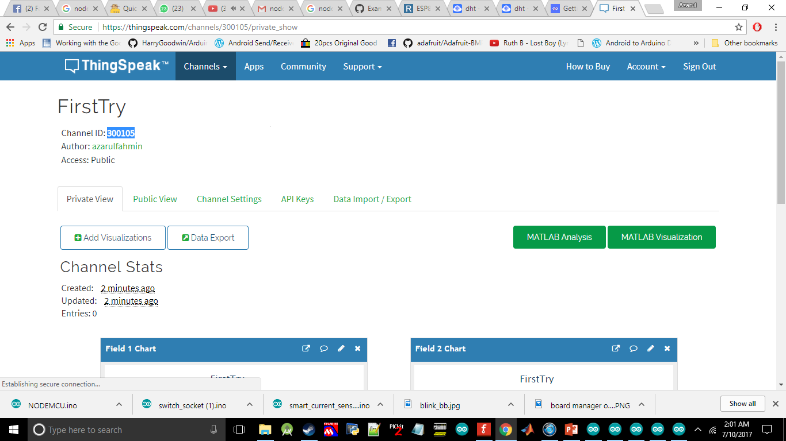
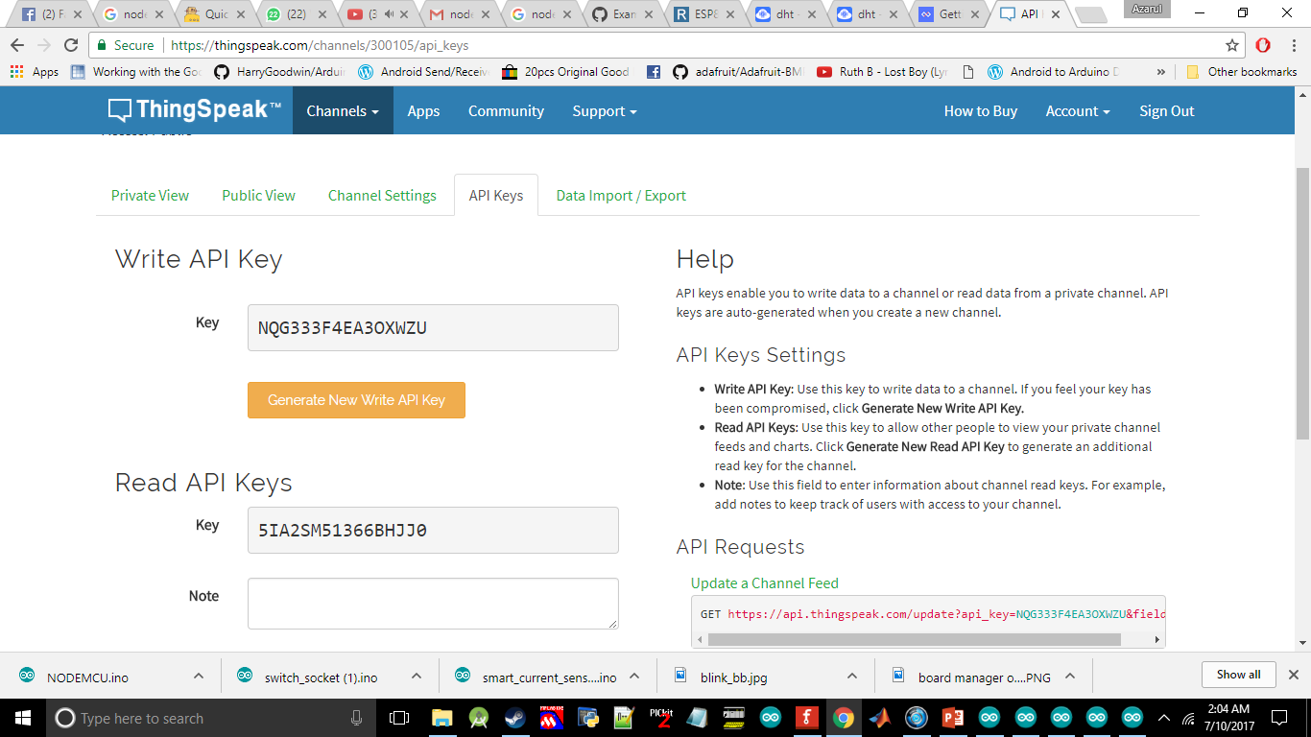
Lesson 3 : Sending data from NodeMCU to the cloud then mobile apps
Save your Channel ID in notepad
1
2
Save also this two api key

Slide 23
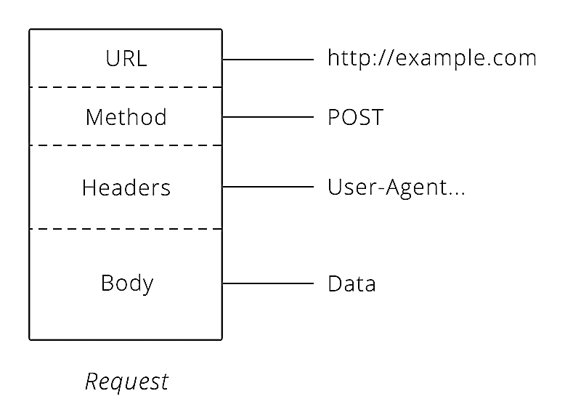

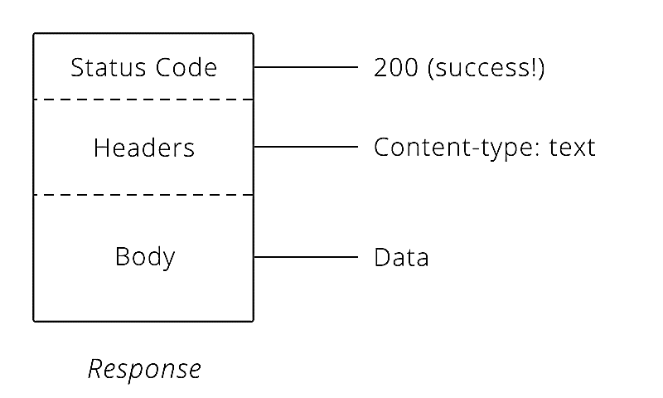

Lesson 3 : Sending data from NodeMCU to the cloud then mobile apps
HTTP Request
HTTP Response
HTTP Request

Slide 24
Lesson 3 : Sending data from NodeMCU to the cloud then mobile apps
1
POST /update HTTP/1.1
Host: api.thingspeak.com
Connection: close
X-THINGSPEAKAPIKEY: GVJHFB678JHU
Content-Type: application/x-www-form- urlencoded
Content-Length: 20 Data: field1=30&field2=40

Slide 25
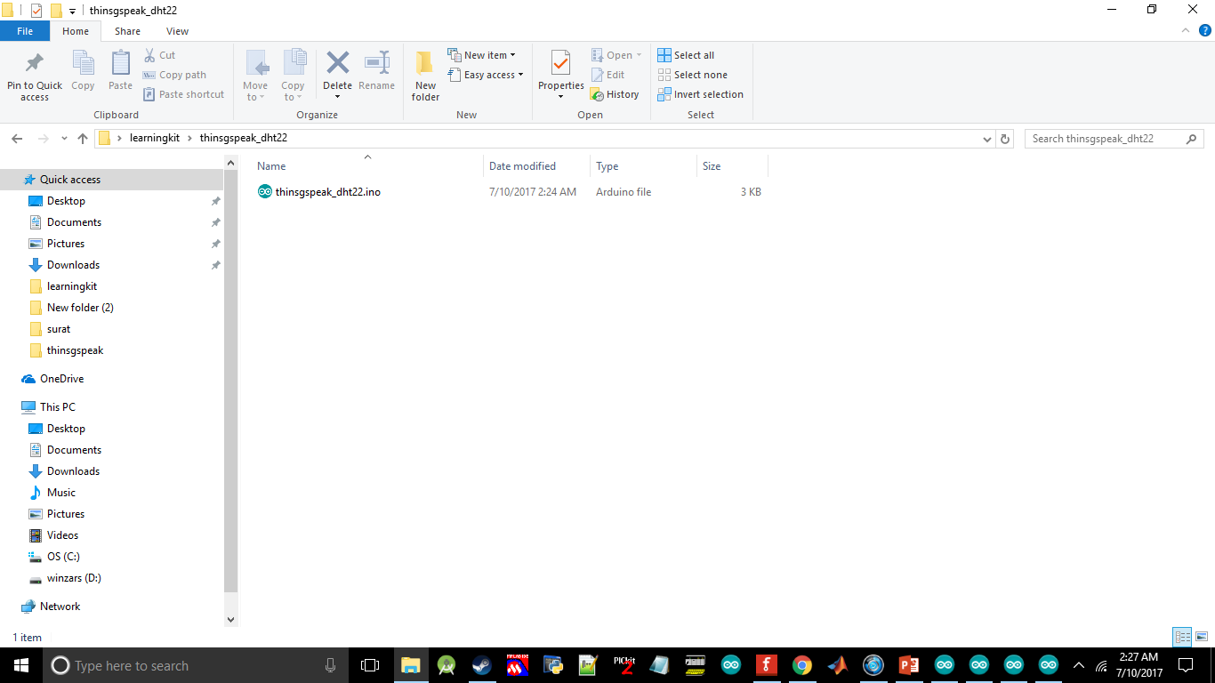
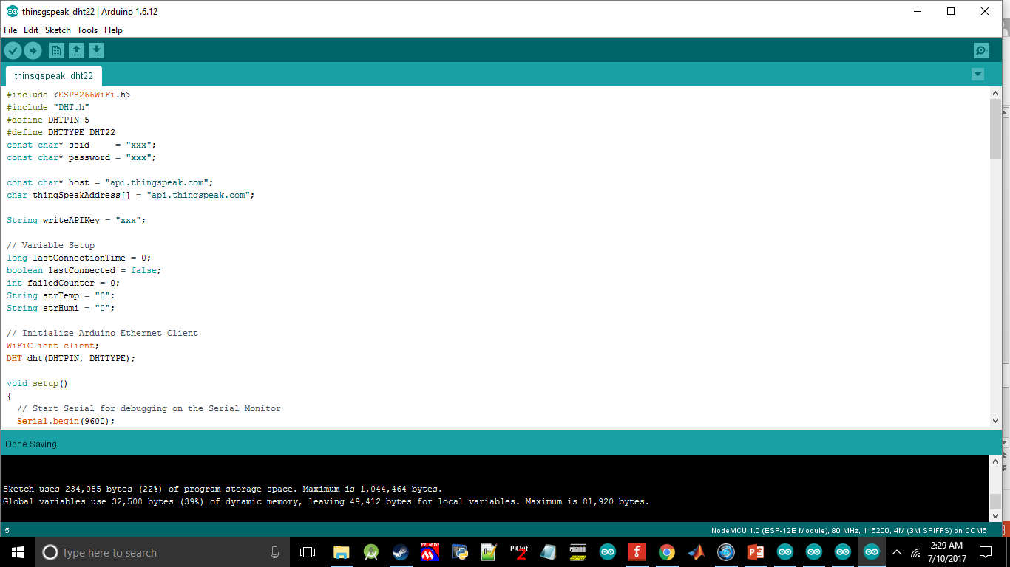
Lesson 3 : Sending data from NodeMCU to the cloud then mobile apps
Open thingspeak_dht22.ino
1
After done. Please take a look at thinspeak channel to see your incoming data.
2
Change xxx at ssid according to your Wi-Fi name
Change xxx at password according to your Wi-Fi password Change xxx at writeAPIKey according your api key in thingspeak

Slide 26
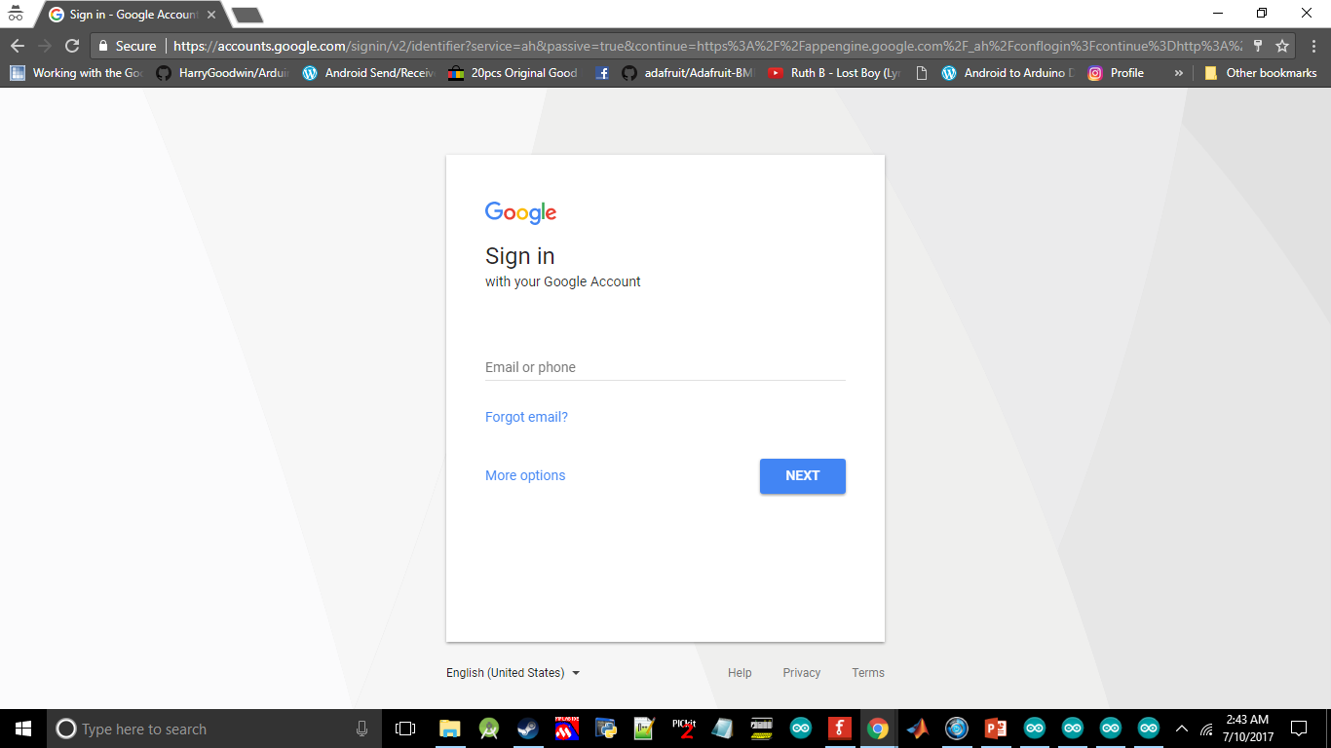
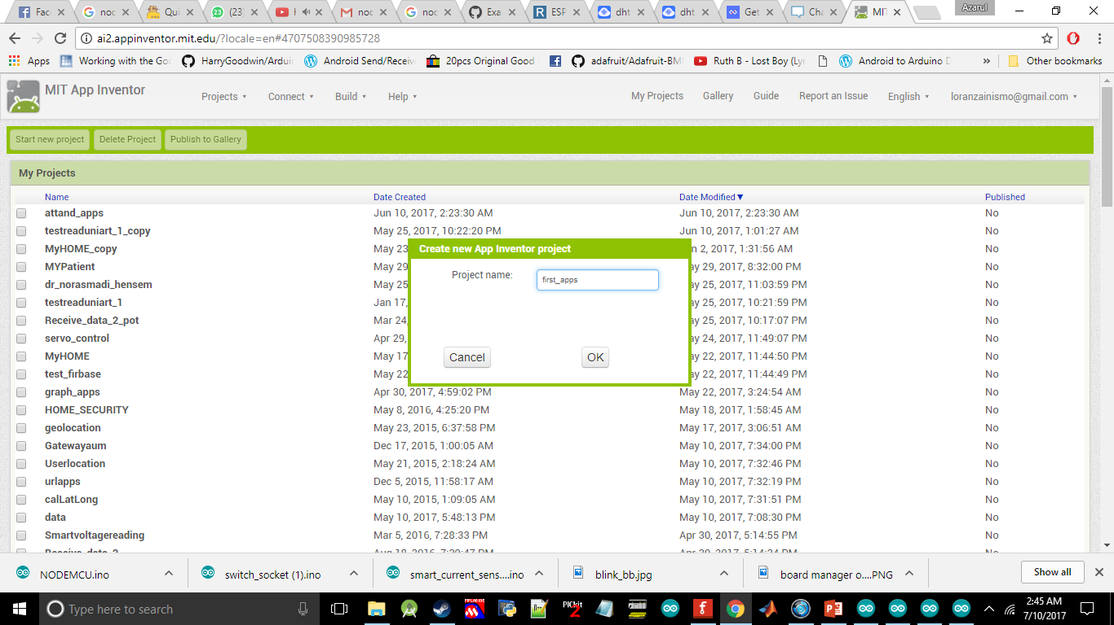
Lesson 3 : Sending data from NodeMCU to the cloud then mobile apps
Open http://ai2.appinventor.mit.edu/ and signup
1
2
Start new project and give a name to your apps

Slide 27
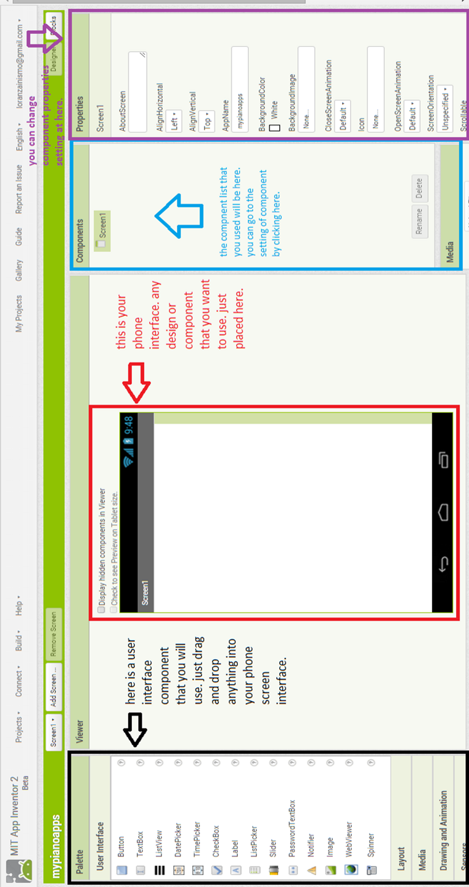
Lesson 3 : Sending data from NodeMCU to the cloud then mobile apps

Slide 28
Lesson 3 : Sending data from NodeMCU to the cloud then mobile apps
To change your properties for your component. You need to edit it here.
All the component that you take from pallete will be shown here.

Slide 29
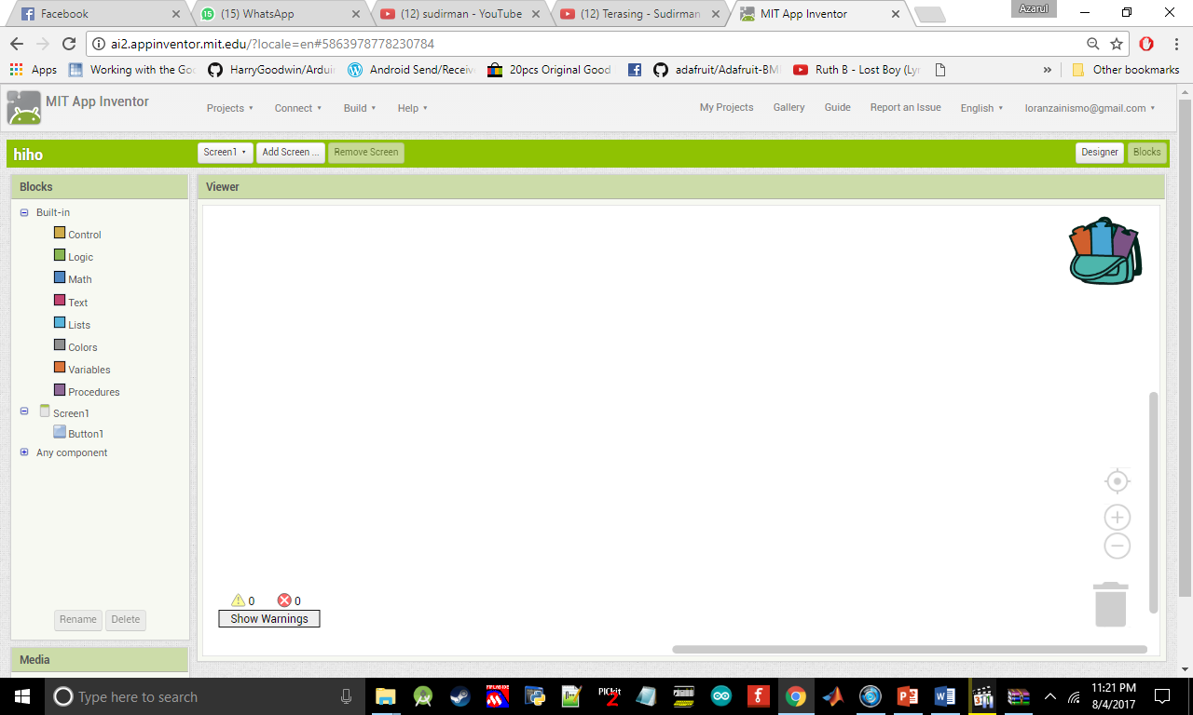
Lesson 3 : Sending data from NodeMCU to the cloud then mobile apps
Here is all of syntax that you will use in programming the android apps. The block that you drag form here can be compare by the colour of the block
If you want to delete your block you can dump in this bin

Slide 30
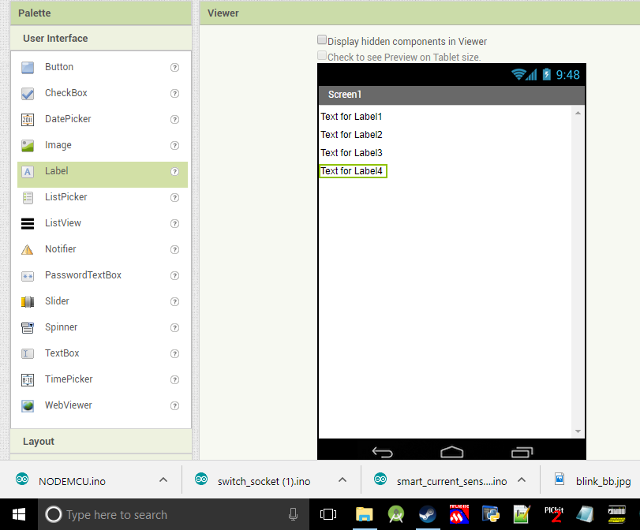
Lesson 3 : Sending data from NodeMCU to the cloud then mobile apps
Drag 4 Lable into your screeen

Slide 31
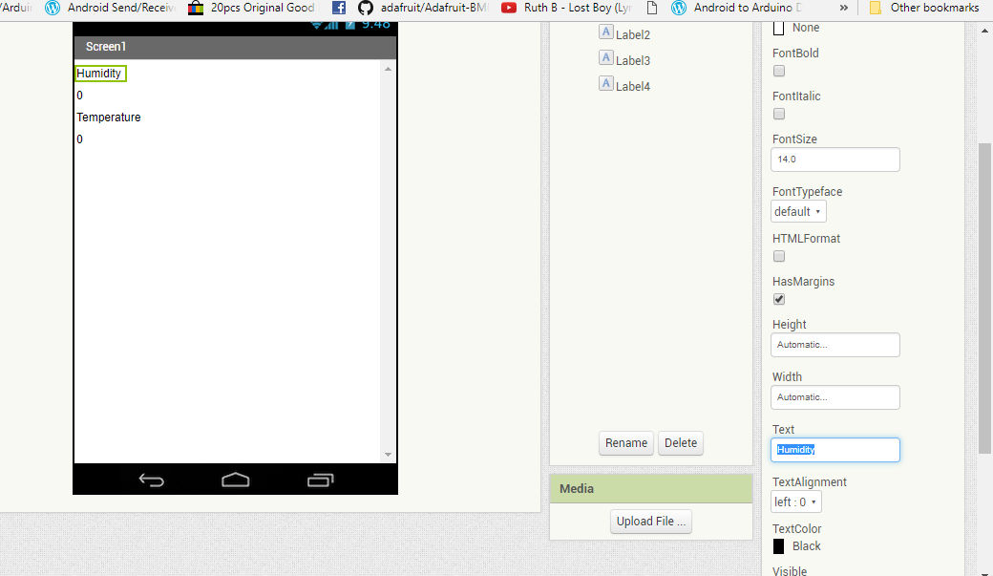
Lesson 3 : Sending data from NodeMCU to the cloud then mobile apps
You need to change text for each label at here.

Slide 32
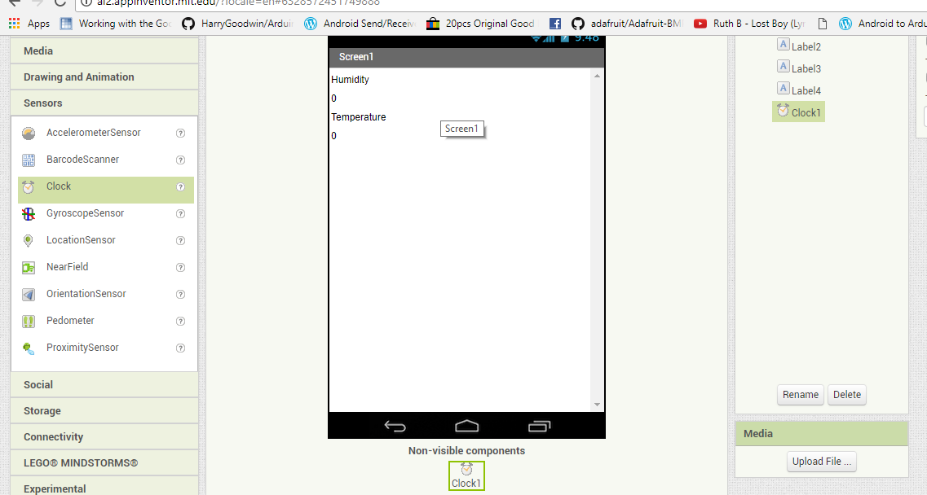
Lesson 3 : Sending data from NodeMCU to the cloud then mobile apps
Put clock into screen that you can get from Sensors

Slide 33

Pelajaran 3 : Hantar data dari NodeMCU ke Android apps melalui cloud
Drag two Web form Connectivity into screen

Slide 34

Lesson 3 : Sending data from NodeMCU to the cloud then mobile apps
Go to the block then drag all of this component into the coding space

Slide 35

Lesson 3 : Sending data from NodeMCU to the cloud then mobile apps
Put https://api.thingspeak.com/channels/channel id anda /fields/ nombor field /last? Into text field

Slide 36

Lesson 3 : Sending data from NodeMCU to the cloud then mobile apps
Put Clock1.Timer and call web get

Slide 37

Lesson 3 : Sending data from NodeMCU to the cloud then mobile apps
Drag web1 and web2 got text

Slide 38

Lesson 3 : Sending data from NodeMCU to the cloud then mobile apps
Go to the build and click on App(save .apk to my computer). Then install it in your phone

Slide 39


1
Lesson 4 : Send data from android smart phone to NodeMCU through cloud
Put the LED at D7
2
Open thingspeak_controlled.ino

Slide 40

Lesson 4 : Send data from android smart phone to NodeMCU through cloud
Create another Thingspeak channel
that will used in this lesson
Change xxx at ssid according to your Wi-Fi name
Change xxx at password according to your Wi-Fi password
Change xxx at myReadAPIKey according to your read api key Change xxx at myChannelNumber according to the channel number

Slide 41

Lesson 4 : Send data from android smart phone to NodeMCU through cloud
Drag 2 button into screen1

Slide 42

Lesson 4 : Send data from android smart phone to NodeMCU through cloud
Change the button text into
ON and OFF

Slide 43

Lesson 4 : Send data from android smart phone to NodeMCU through cloud
Drag 2 web into screen

Slide 44

Lesson 4 : Send data from android smart phone to NodeMCU through cloud
Algorithm at the block part

Slide 45

If(data == 30){
//ON LED } else //OFF LED
Lesson 4 : Send data from android smart phone to NodeMCU through cloud
https://api.thingspeak.com/update?api_key=write api key &field anda =data
DONE! Build The Apps

Slide 46


1
Put the LED into D7 and
Combine with DHT sensor
Lesson 5: Combine the lesson 4 and 5
2
Open file thingspeak_combine.ino

Slide 47
Lesson 5: Combine the lesson 4 and 5
Build your own android apps

